Slide 1
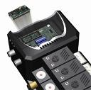
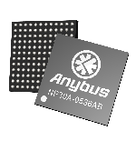
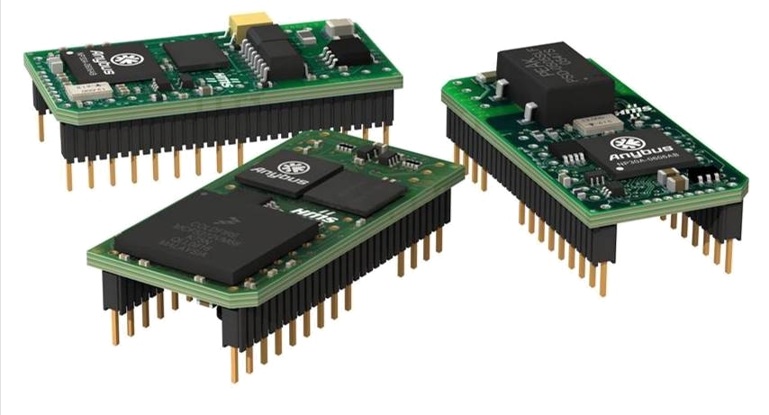
Anybus-IC
Technical User Overview
www.anybus.com www.biasystem.co.kr
Status: Q1/2008

Slide 2
Anybus-Communicator 적용시의 장점 01
1. 국내 및 해외 30여 개국 1,000,000 Application 적용 실적으로 안정성 및 범용성 보장.
(국내 적용사례 :삼성전자, 하이닉스, LG Philips LCD,현대자동자, 현대중공업, 포스코,
인천 신공항, KTX, 등 외 중소기업 300여 곳 1,000 Application 적용).
2. 다양한 현장에서 필드의 검증을 기반으로
고급 엔지니어나 검증기간 없이 쉽게 통신 설정 그리고 제품 안정성 보장
(Development Application Programming을 위하여 3-6개월 개발기간 단축 가능)
3. 전세계에서 지향하는 주요 Fieldbus 시스템 그리고 근간 이슈화 되고 있는 산업용 이더넷
지원으로 최신 통신 시스템 구축보장.
4. 주요한 통신시스템의 다양한 지원으로 향후 유지보수나 신규 통신 추가 개발시
이 기종 통신의 유연한 연결성 보장.
5. Application 에 적용 시 빠르고 안전하게 최적의 하드웨어와 소프트웨어 사용.
다양한 필드버스,이더넷등을 디바이스에 적용시 Chip변경 사용으로.
각각의 디바이스별 설정없이, 동일하드웨어와 소프트웨어 사용으로 개발 및
프로그래밍시간 단축.

Slide 3

Anybus-Communicator 적용시의 장점 02
5. 전세계 표준화된 Configuration-Tool이용 유기적 호환 상위 통신 시스템과 하위 디바이스
간의 손쉬운 모니터링, 디버깅기능 또는 상위 통신 시스템과 하위 디바이스 간의
분쟁시 중요한 해결사 역할.
6. PC를 이용한 플래쉬 메모리 다운로드 기능으로 새로운 통신 Software 자동
Up Grade.
7. Serial, USB, WireLess 또는 모든 주요한 필드버스나 산업용 이더넷 통신 시스템
설계시 다양한 기능과 제품으로부터 유연하게 대응.
8. 개방형 통신시스템(필드버스, 산업용 이더넷등) 기반설계, 다양한 제품들과
유기적 호환.
9. CE, UL & cUL등, Fieldbus 협회 16개 인증 제품.

Slide 4
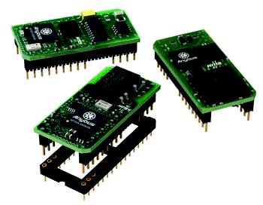





Anybus-IC Single Chip Network Interface
Small sized network interfaces with the footprint of a DIL-32 socket
for integration into automation devices
Complete network interface
Certified and proven
Interchangeable
IO data and acyclic parameter
Direct I/O in stand alone mode
Serial UART-interface
Serial configuration interface
Galvanic isolation integrated
Low power consumption
Fieldbus versions based on
HMS NP30 microprocessor

Slide 5
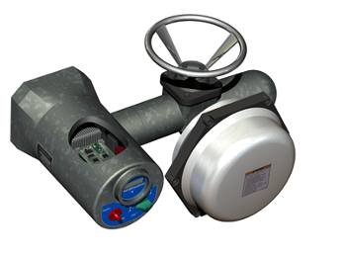
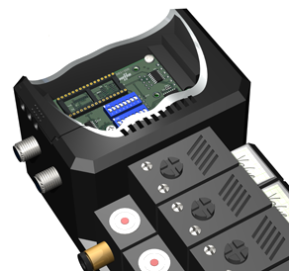
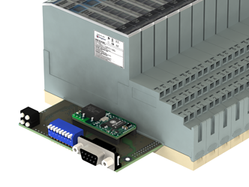
Typical Applications
Anybus-IC is optimized for use within small sized automation devices
Anybus-IC provides a complete communication interface
Network connector, switches and indicators are not included and can be added according to the requirements of the application
Anybus-IC is suitable for devices with IP65 mechanical rating
In stand-alone mode, Anybus-IC can directly control up to 128 bit of I/O
Via its serial UART interface, Anybus-IC can be connected to almost any standard microcontroller
actuators / sensors
I/O blocks
valve blocks

Slide 6
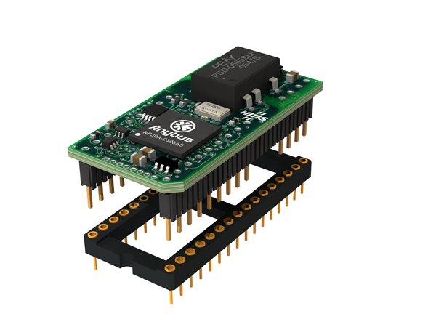
Anybus-IC Overview
integrated galvanic isolation
Anybus NP30 microcontroller
including network ASIC,
RAM & Flash memory
network interface pins
single 5 Volt supply
application interface pins
SSC, MIF, SCI
DIL-32 chip socket
(not included in delivery)
Dimensions: 42 x 21 x 15 mm (L x W x H)

Slide 7

Anybus-IC Hardware Interface
The hardware interface consists of two asynchronous serial ports, a synchronous interface for direct I/O and the network interface
DI1
Direct IO Interface (SSI)
Synchronous Serial Interface
(TTL Signal Levels)
DI2
LD
CLK
DO
Network Interface
(function depending on specific network type)
Reset
UART Interface (SCI)
Serial Communication Interface
(TTL Signal Levels)
RX
TX
UART Interface (MIF)
Monitor & Configuration Interface
(TTL Signal Levels)
RX
TX
Anybus-IC
Power Supply 5 Volt
5V
GND

Slide 8
Direct Digital or Analog I/O
Via its synchronous SSC interface, the Anybus-IC can control up to 128 bit direct Inputs and max 128 bit direct Outputs
Network independent
device electronics
Network specific
interface
Analog Input
A
D
Digital Input
Node Address
Shift Register
Shift Register
Shift Register
DI
LD
CLK
Shift Register
Shift Register
Shift Register
DO
D
A
Digital Output
Diag LED´s
Analog Output
Serial UART Interface
Anybus-IC
Serial Configuration Interface
5 Volt Supply

Slide 9
Anybus-IC Software Interface
The software interface is based on a subset of the
serial Modbus-RTU communication protocol
Modbus-RTU Master
Modbus-RTU Slave
request frame
Host
microcontroller
response frame
SCI
Interface
Anybus-IC
Each Sequence:
consists of a request and a response frame
is time controlled with a watchdog function
Network
Interface
Each frame:
contains a function code, address, data, parameter
contains a CRC checksum (can be switched off)

Slide 10
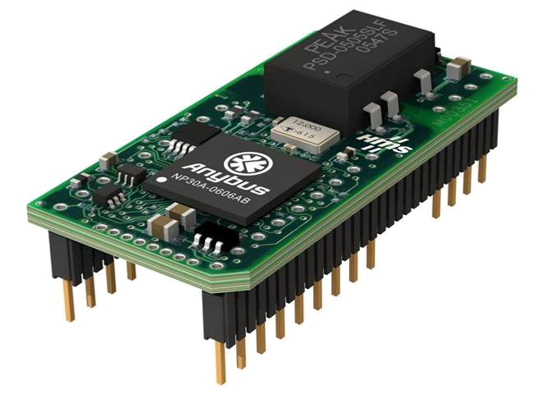

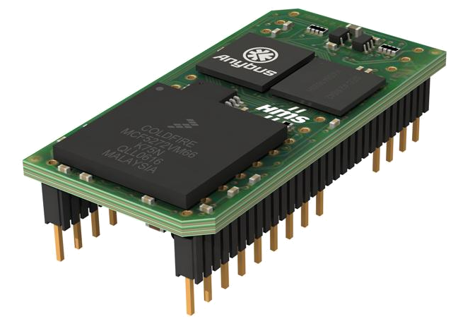

Anybus-IC Functional Overview
Complete Profibus-DP slave interface
Automatic baud rate detection 9.6 kbit/s up to 12 Mbit/s
Supports user parameter data and extended diagnostic data
Complete DeviceNet adapter (slave) interface
Baud rate 125 kbit/s up to 500 kbit/s
Supports implicit IO slave messaging and explicit messaging
Complete EtherNet/IP adapter (slave) interface
Baud rate 10 or 100 Mbit/s
Supports implicit IO slave messaging and explicit messaging
Embedded web server, FTP-Server, E-mail client, TCP/IP sockets
Complete Modbus-TCP server (slave) interface
Baud rate 10 or 100 Mbit/s
Embedded web server, FTP-Server, E-mail client, TCP/IP sockets
Up to 128 byte Input and 128 byte Output data via SCI UART interface
Up to 128 bit direct Input and 128 bit direct Output via SSC interface
DIL 32 housing, 5 Volt supply
Common
Features

Slide 11

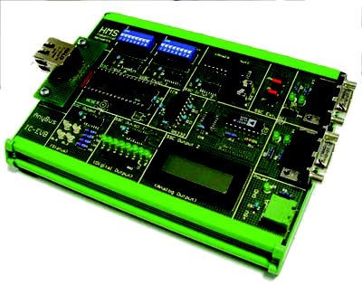

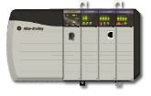
Qualified Development Support
Analysis of the communication requirements
Guidance how to find the best interface solution
Make versus buy analysis
Free Anybus developer workshops
Before
Development
Evaluation board and master simulator tools
Application examples
Application interface software in source code
Free qualified technical support
Assistance during creation of EDS, GSD files
Verification with real PLC in the HMS office
During
Development
Guidance for a successful certification
Configuration examples for all major PLCs
Free qualified technical support
Continuous technology maintenance
After
Development

Slide 12
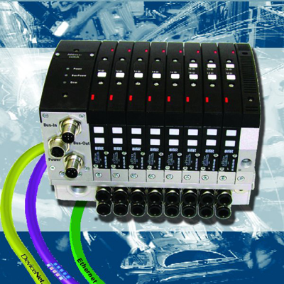

Customer Example: Airtec
Karl-Heinz Hoppe from Airtec says: “HMS provides turnkey solutions for interfacing field devices to a wide range of different bus systems. There is not much free space for the bus coupler in our valve terminals, and thus the HMS Anybus-IC was clearly ideal for this purpose due to its very compact design. An important factor was that the HMS Anybus technology would allow interfacing to all important fieldbus systems within a very short time scale.”

Slide 13
Advantages with Anybus-IC
Anybus-IC is a very small and powerful network interface optimized for small and medium sized automation devices
reduced development efforts
short time-to-market
flexible solution for many networks
full interchangeability
no specific development tools
the main processor of the automation
device remains unchanged
continuous maintenance by HMS
simplified certification

Slide 14
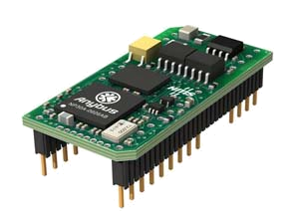
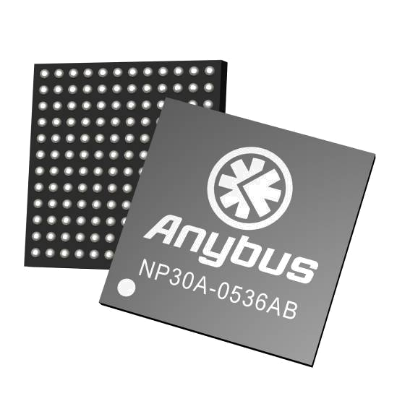
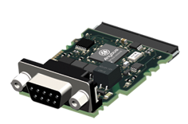
Standard and Custom Solutions
HMS offers a wide range of standard and custom solutions based on
- the experience from more than 1,000,000 sold modules
- highest manufacturing quality and flexible logistics
standard modules
(standard hardware + standard software)
full custom solutions
custom modules
(custom hardware + standard software)
full custom solutions
annual volume
500 units/year
1,000 units/year
5,000 units/year
10,000 units/year

Slide 15




Let Our Knowledge Work for You
www.anybus.com

